Slide 1
Early Humans
Chapter 1, Section 1

Slide 2
History
The story of humans in the past
Prehistory
The story of humans before writing

Slide 3
Anthropologist
Studies human society
Studies how humans developed

Slide 4
Archaeologist
Studies evidence of humans. They find and study artifacts and fossils that are buried in the ground.

Slide 5
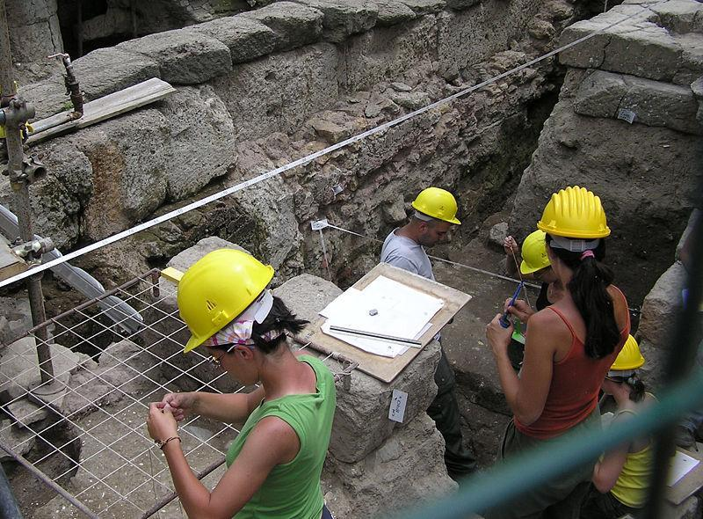
Archaeologists

Slide 6
Louis and Mary Leakey
Famous archaeologists
Discovered evidence that shows humans began in East Africa millions of years ago

Slide 7
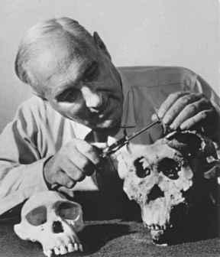
Leakey examining remains from Olduvai Gorge…a place in Tanzania, Africa.

Slide 8
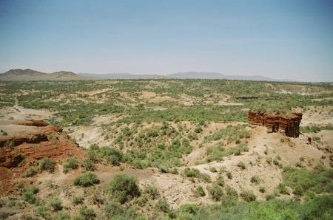
Olduvai Gorge in Africa

Slide 9
Hominid
Creature that walks on two legs
Humans are the only hominid today
Hominid: Lucy
Found in Ethiopia in 1974
Discovered by Donald Johanson
3 million year old female Hominid
Head the size of a baseball
25 years old

Slide 10
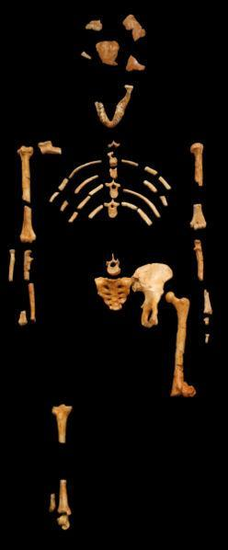
Lucy’s Remains

Slide 11
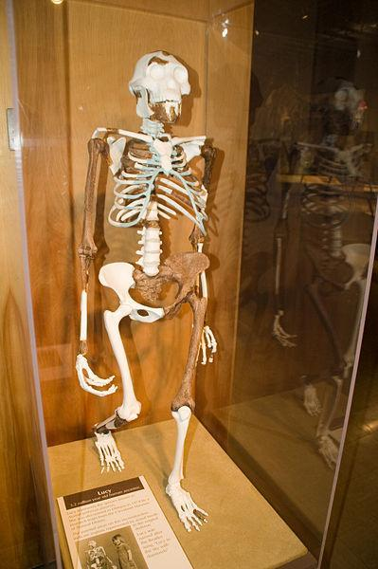
Replica of Lucy

Slide 12
Hunter-Gatherers
Hunted and gathered food
Did not live in a permanent home
The Madeleine people

Slide 13
Paleolithic Age
Old stone age
Tools and weapons were only made of stone
No permanent civilizations
Hunter-gatherers
2,500,000 B.C. – 8,000B.C.

Slide 14
Nomad
Person who is always on the move and does not have a permanent home
The Madeleine people

Slide 15
Ice Age
A long period of extreme cold
100,000 B.C. – 8,000 B.C. was the last ice age
Ice sheets covered parts of Europe, Asia, and North America
People adapted by using clothing and fire
The Madeleine people

Slide 16
Adaptations
Paleolithic people had to adapt to their environment.
The Madeleine people
Lived in caves in cold climates
Learned to tame fire which provided warmth, light and a way to cook meat.
Used animal furs to make warm clothing.

Slide 17
Language
Spoken language was developed during the Paleolithic times

Slide 18
Paleolithic Art
Cave paintings
Used crushed yellow, black and red rocks to make powders for paint
Expressions of the humans of the time

Slide 19
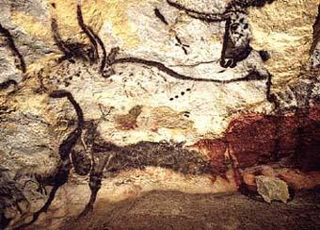
Found in Lascaux caves, France

Slide 20
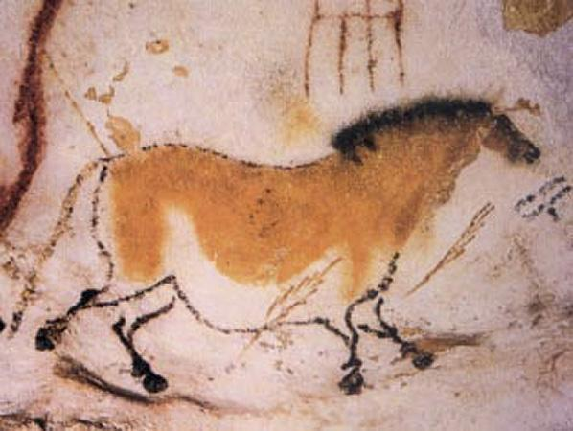

Slide 21
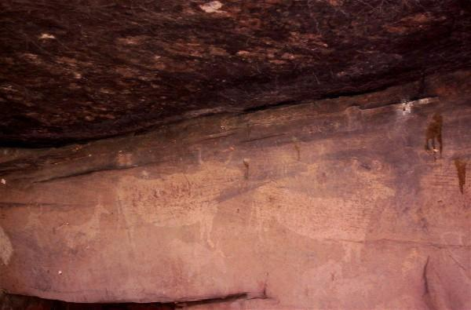
Bulls in a Spanish cave

Slide 22
Technology
Tools and methods that help humans perform tasks
The first technology was a piece of stone
What forms of technology do the Madeleine people use to adapt to their environment?

Slide 23
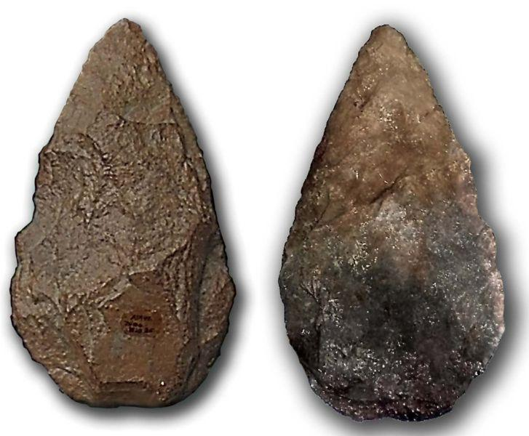
Paleolithic Technology

Slide 24
Mesolithic Age
Middle stone age
People started herding animals instead of hunting them
Used animals for meat, milk, and wool
People remained nomadic

Slide 25
Domesticate
To tame animals for human use

Slide 26
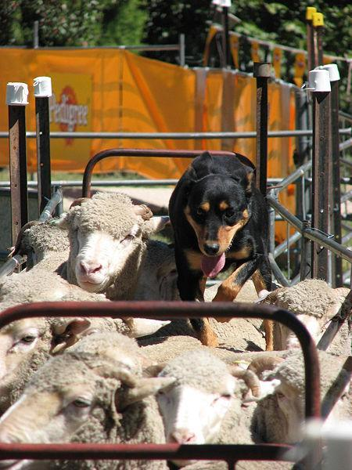

Slide 27
Neolithic Age
New Stone Age
8000 B.C. – 4000 B.C.
People started settling into communities
Planting and growing seeds
Replaced hunting and gathering

Slide 28
Agricultural Revolution
The change that occurred during the Neolithic Age
Could be the most important event in human history
Why?
What does the word revolution mean?

Slide 29
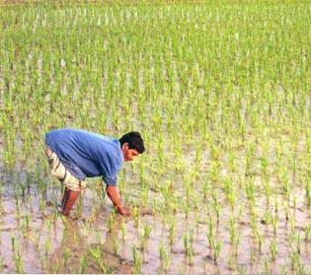

Slide 30
Pros of Neolithic Age
People could stay in one place
More people could be fed/steady food supply/surplus of food
Population of world could increase
People could learn other trades besides farming
Specialization of labor
Better technology

Slide 31
Cons of the Neolithic Age
Not as much variety in their diets
More grain and less meat was consumed
Staying in one place caused diseases to spread quickly
Pollution contaminated water supply

Slide 32
Two early Neolithic towns
Jericho
the oldest community found in the Middle East
Located near Israel
8000 B.C.
Catal Huyuk
6700 B.C.
Population 6000
Located in present day Turkey

Slide 33
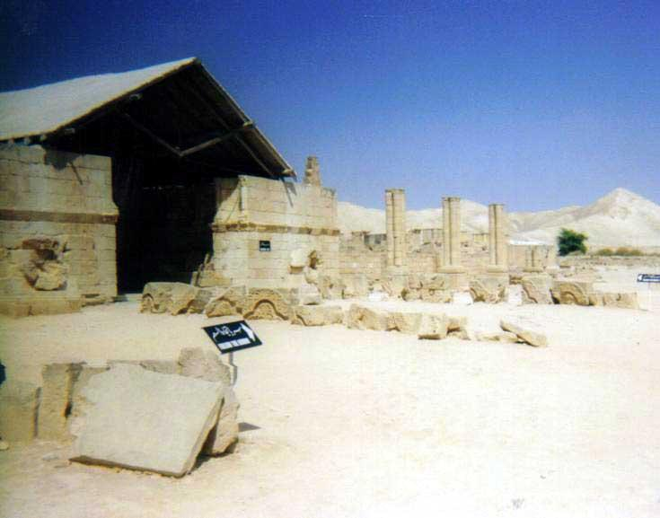
Archaeological site in Jericho

Slide 34
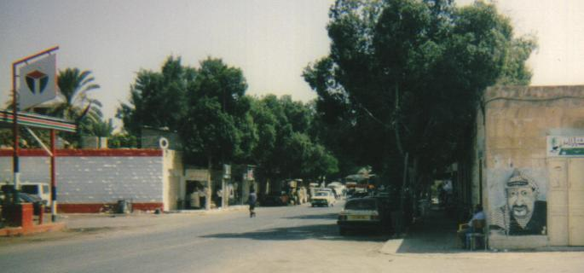
Modern Jericho

Slide 35
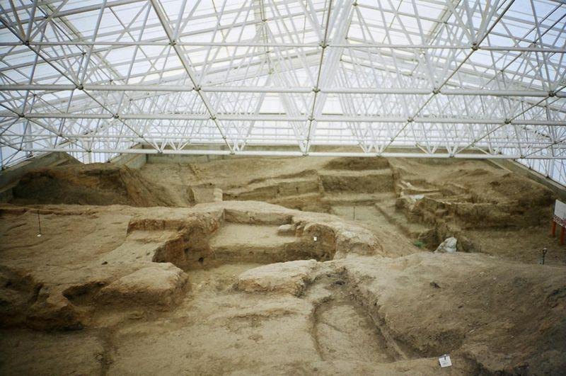
Archaeological site at Catal Huyuk

Slide 36
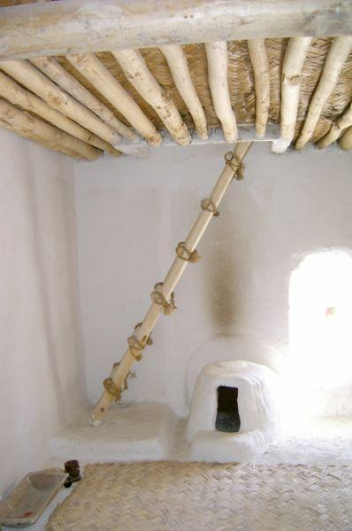
Restoration of a typical house in Catal Huyuk

Slide 37
Specialization of labor
Different jobs for different people
As people settled into communities, some people farmed and others did other jobs and traded for food

Slide 38
Bronze Age
After 4000 B.C.
Mixed copper and tin = bronze
Bronze made better weapons and tools than stone or copper
What is next for early civilization?

